Slide 1
Pokedex App
Francisco, Yousef, Geovanni, John, Elliot

Slide 2

Problem Statement
With our app, Pokémon enthusiasts can use their smart phone to take a photo of any gen 1 pokemon and be provided with all the information you’d find in a pokedex entry, so that they may learn more about the Pokemon and be able to know which Pokemon to use in battles.

Slide 3
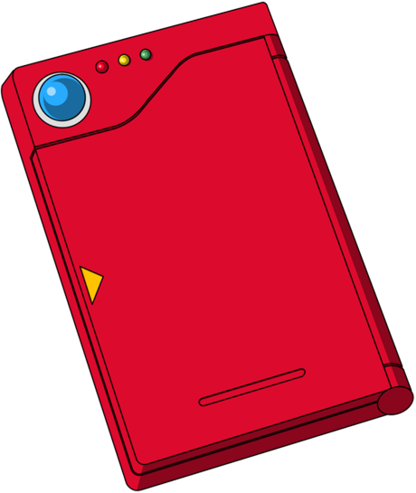
Customers
Diehard Pokémon fans who want to check their knowledge or work on memorizing new Pokémon info
New Pokémon fans who do not yet know every Pokémon but want to learn more
Competitive Pokémon players who need quick and easy access to information about each of their Pokémon
Companies like Nintendo and Gamefreak because it facilitates use of their games/products

Slide 4
Scenario
Bob was watching the Pokémon anime for the first time and was fascinated by their abilities. He was unfamiliar with some of those Pokémon and wanted to learn more about them. Bob opened the Pokedex app to take pictures of the Pokémon in the show and found out who they are as well as some fun facts about each one.

Slide 5
Monetization
Include Ads:
Show image of ad on home screen
Play video ad after user takes photo

Slide 6
Demo

